Slide 1



Superstore Report
View in Power BI
Last data refresh:
3/29/2024 10:44:13 AM UTC
Downloaded at:
3/29/2024 11:32:51 AM UTC

Slide 2
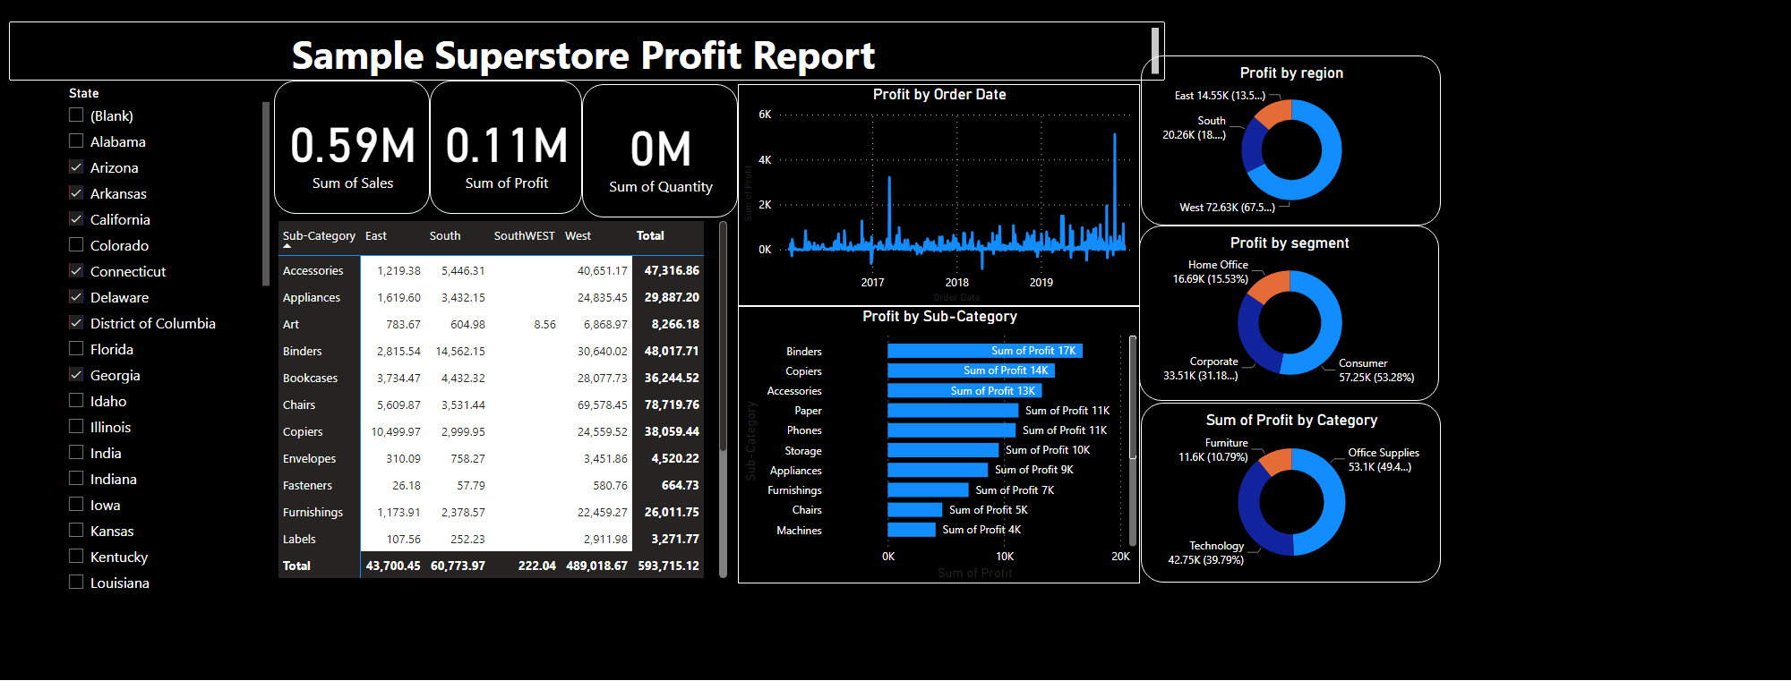
Page 2
Notes:
textbox
No alt text provided
Profit by segment
No alt text provided
donutChart
No alt text provided
Profit by region
No alt text provided
Profit by Sub-Category
No alt text provided
Profit by Order Date
No alt text provided
slicer
No alt text provided
pivotTable
No alt text provided
card
No alt text provided
card
No alt text provided
card
No alt text provided

